Slide 1




Topic 4
REQUIREMENTS DETERMINATION
SYSTEMS ANALYSIS AND DESIGN

Slide 2


LEARNING OBJECTIVES
SEGI UNIVERSITY
01
The analysis phase.
02
Requirement determination.
03
Requirement elicitation techniques
04
Requirement analysis strategies.

Slide 3
.
ANALYSIS PHASE
SEGI UNIVERSITY
Analysis refers to breaking a whole into its parts with the determined of understanding the parts’ nature, functions, and interrelationships.
The planning phase deliverables are the key inputs into the analysis phase.
The basic process of analysis involves three steps:
Understand the existing situation (the as-is system)
Identify improvements
Define the requirement for the new system (the to-be system).

Slide 4
ANALYSIS PHASE (cont)
SEGI UNIVERSITY
The final deliverables of the analysis phase is the system proposal.
The system proposal is presented to the approval committee in the form of a system walk-through to explain the system in moderate detail.
The deliverables from the analysis phase are the first step in the design of the new system.

Slide 5
Analysis
Typical Inputs and Outputs
Project Plan
Three Core Processes:
1. Understanding the current system
2. Identifying Improvements
Analysis
3. Developing concept of new system
Updated Project Plan & Schedule
Requirements Traceability Matrix*
System Proposal

Slide 6
ANALYSIS PHASE (cont)
SEGI UNIVERSITY
Objective 1: to understand the business requirements of the new (or ‘to-be’) system
  May need to analyse the current (or ‘as-is’) system
Objective 2: to develop a system that addresses the requirements
  Incorporates initial system design
  An entirely new system may not be needed
‘Requirements determination’ is the most critical step of the entire SDLC

Slide 7
REQUIREMENTS DETERMINATION
SEGI UNIVERSITY
Requirements determination is performed to transform the system request’s high-level statement of business requirements into a more detailed, precise list of what the new system must do to provide the needed value to the business

Slide 8
SEGI UNIVERSITY
What is a Requirement?
Statement of what the system must do or a condition it must meet to satisfy the needs of users, stakeholders, or business objectives.
Focus is on business user needs during analysis phase
Requirements will change over time as project moves from analysis to design to implementation
Commonly prioritised e.g. ‘high’, ’medium’, ’low’ importance

Slide 9
What is a Requirement? (cont)
Requirements describe:
what the business needs (business requirements)
what the users need to do (user requirements)
what the software should do (functional requirements)
characteristics the system should have (non-functional requirements)
SEGI UNIVERSITY

Slide 10
Types of Requirement
Functional Requirements
  A process the system has to perform
  Information the system must contain
Non-functional Requirements
  Behavioral properties the system must have
    Operational
    Performance
    Security
    Cultural and political
SEGI UNIVERSITY

Slide 11
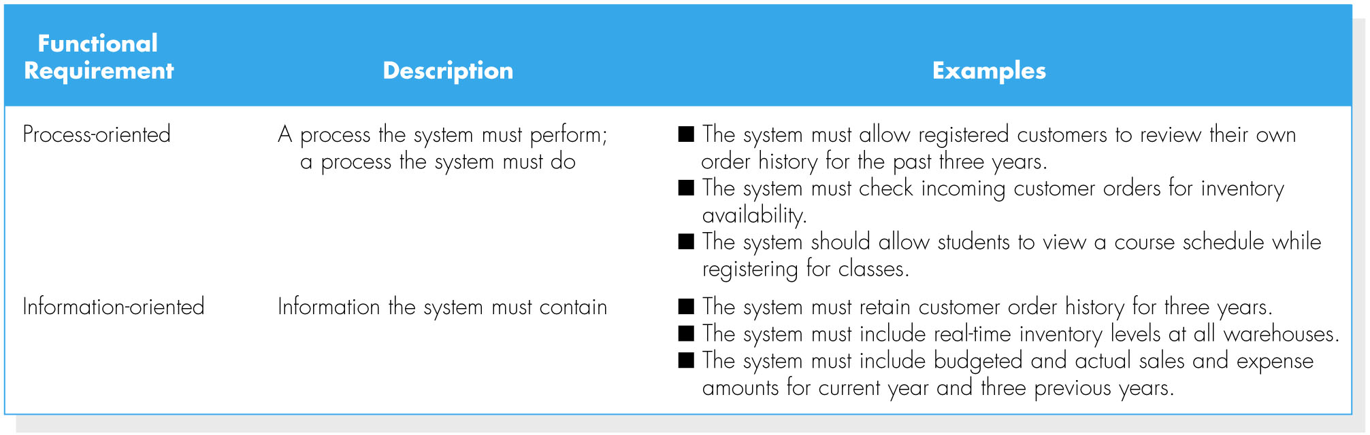
Functional requirements
SEGI UNIVERSITY

Slide 12
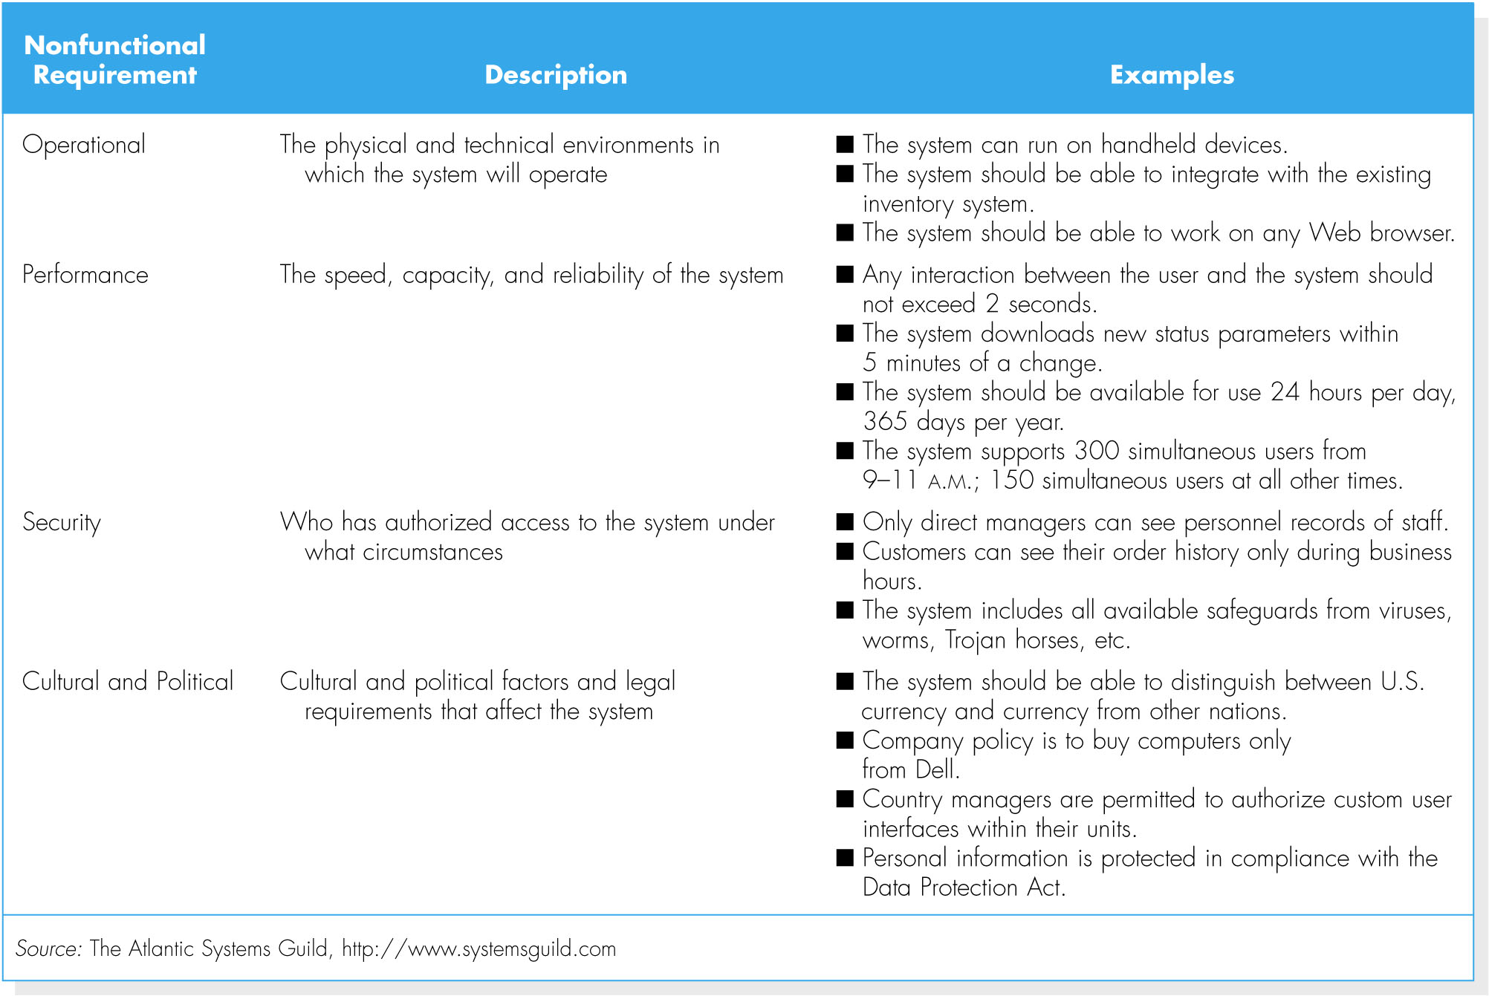
Non functional requirements
SEGI UNIVERSITY

Slide 13
Stakeholders – The Source of
System Requirements
SEGI UNIVERSITY
People with interest in successful system implementation
Three primary groups of stakeholders:
  Users (use system)
  Clients (pay for and own system)
  Technical staff (ensure system operation)

Slide 14
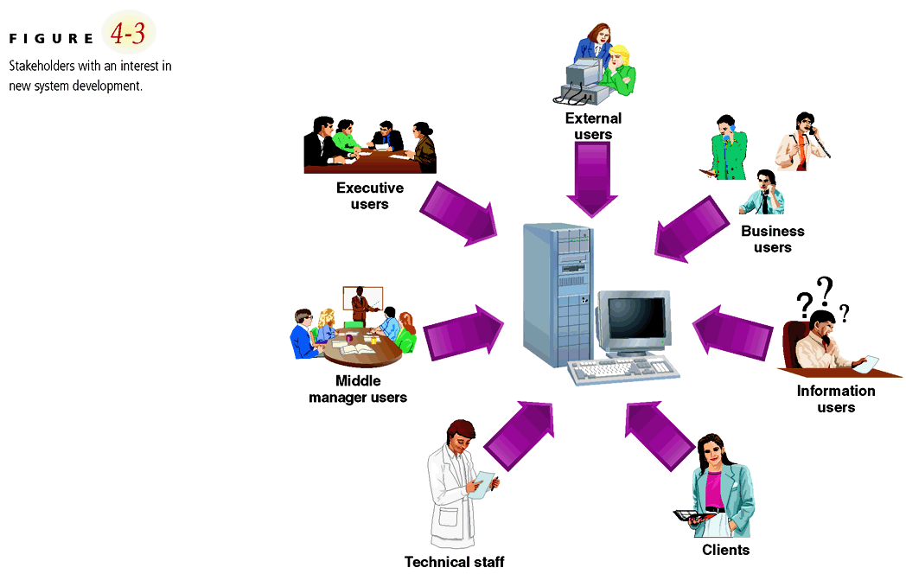
Stakeholders in SDLC
SEGI UNIVERSITY

Slide 15
The Process of Determining Requirements
Both business and IT perspectives are needed to determine requirements during the analysis phase.
The most effective approach is to have both business people and analysts working together to determine requirements.
The analyst must also consider how best to elicit the requirements from the stakeholders.
The process of determining requirements continues throughout the analysis phase, and the requirements definition evolves over time.
SEGI UNIVERSITY

Slide 16
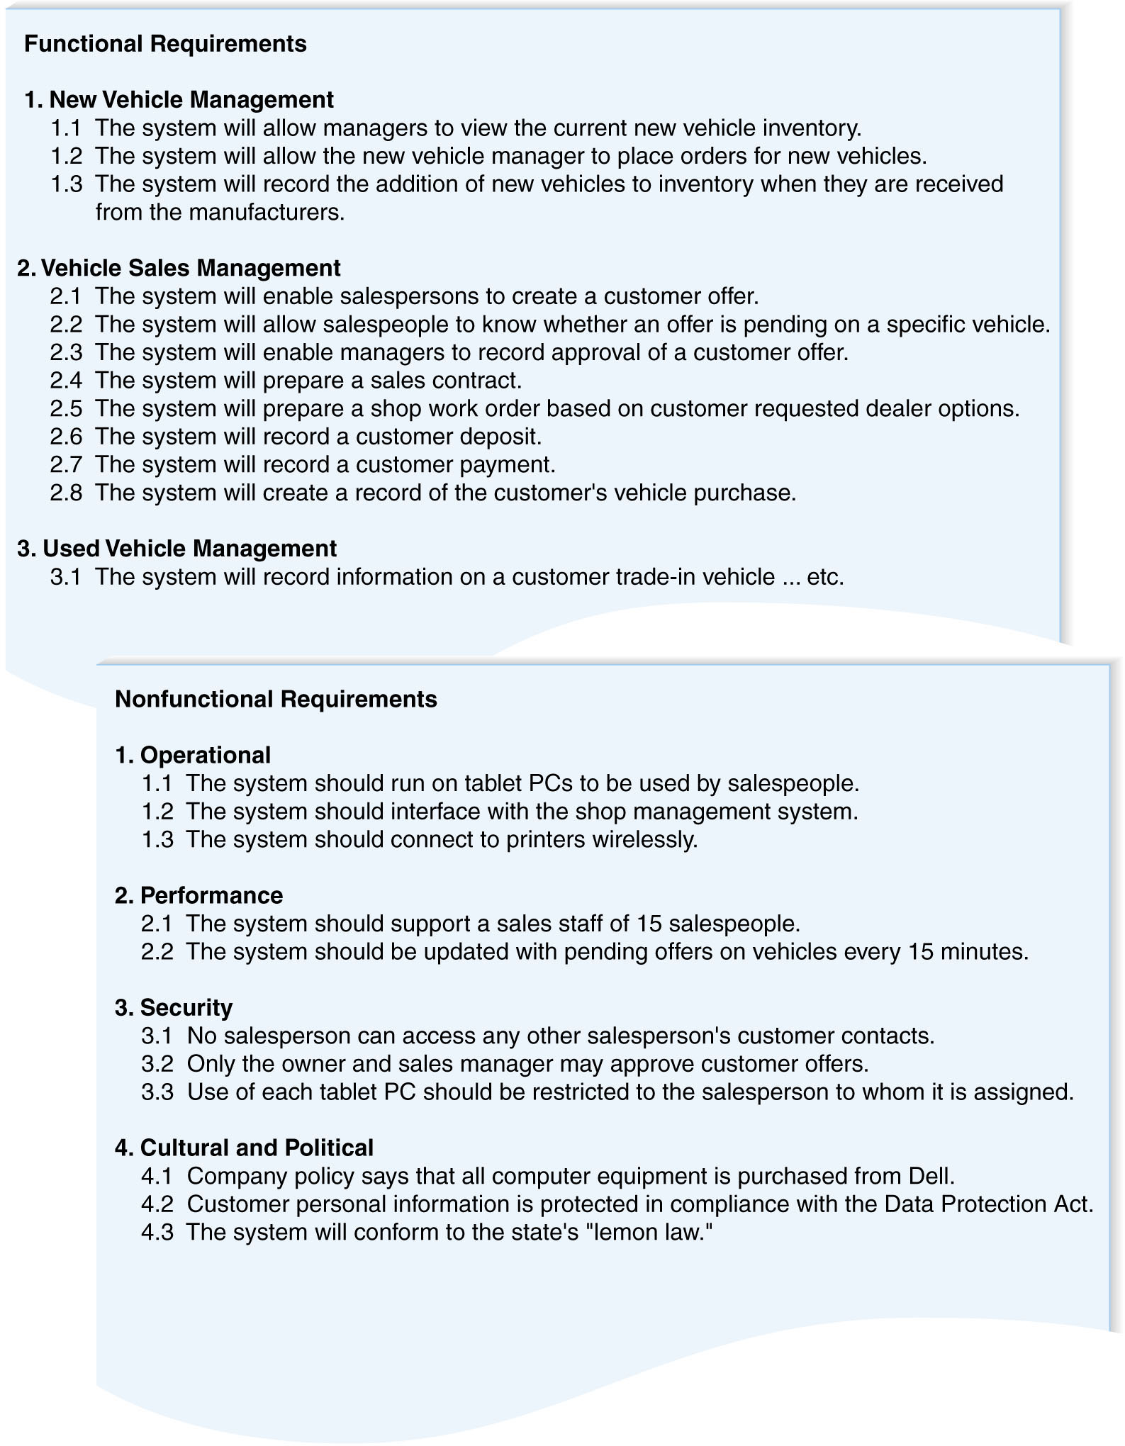
The Requirements Definition Statement
SEGI UNIVERSITY

Slide 17
REQUIREMENTS ELICITATION TECHNIQUES
Traditional Methods
  Interviewing and listening
  Questionnaires
  Observing Users
  Document Analysis
Modern Methods
  Joint Application Design (JAD)
  Prototyping
SEGI UNIVERSITY

Slide 18
Interviews
The most commonly used requirements elicitation technique
Basic steps:
  Selecting Interviewees
  Designing Interview Questions
  Preparing for the Interview
  Conducting the Interview
  Post-Interview Follow-up
SEGI UNIVERSITY

Slide 19
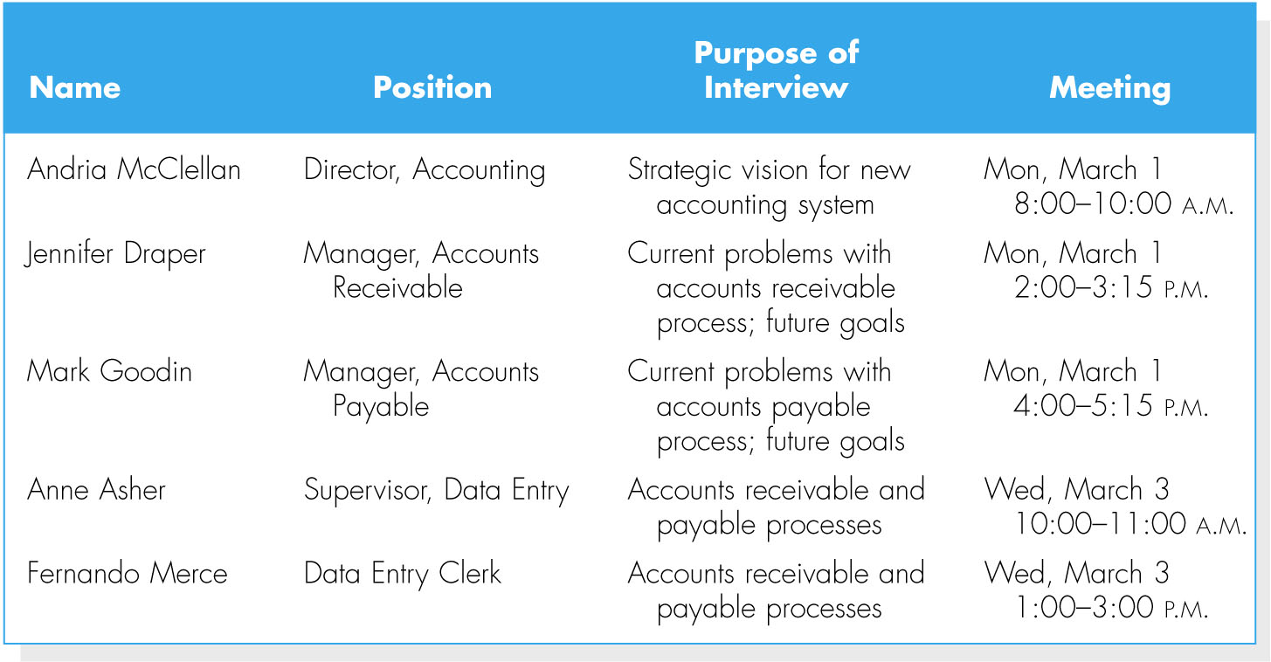
Selecting interviewees
Interview schedule
Including people at different levels of the organization
  Managers
  Users
  Other key stakeholders
SEGI UNIVERSITY

Slide 20
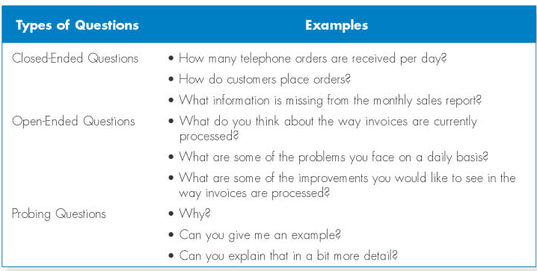
Designing interview questions
SEGI UNIVERSITY

Slide 21
Designing interview questions (cont)
SEGI UNIVERSITY
Unstructured interview
  for a broad and roughly defined set of information
Structured interview
  for very specific information

Slide 22
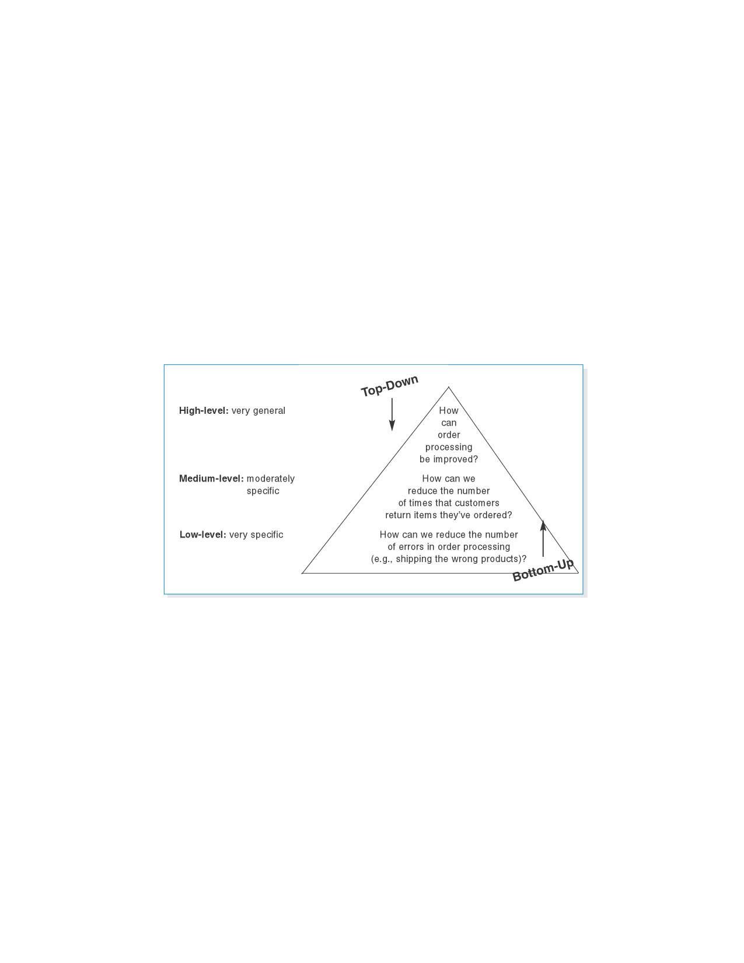
Designing interview questions (cont)
Top-down vs. bottom-up interview
SEGI UNIVERSITY

Slide 23
Preparing for the interview
Prepare a general interview plan
Confirm areas of knowledge
Set priorities in case of time shortage
Prepare the interviewee
  Schedule
  Inform of reason for interview
  Inform of areas of discussion
SEGI UNIVERSITY

Slide 24
Conducting the interview
Appear to be professional and unbiased.
Record all information.
Be sure you understand the issues that are discussed.
Separate facts from opinions.
Give interviewee time to ask questions, and brief explain what will happen next.
SEGI UNIVERSITY

Slide 25
Post-interview follow-up
After the interview, the analysts needs to prepare an interview report.
The report includes interview notes.
The report is sent to interviewee with a request to read it and inform the analyst of clarification and updates.
SEGI UNIVERSITY

Slide 26
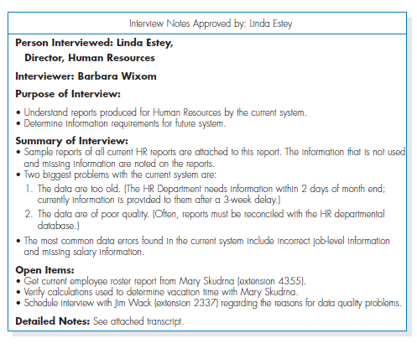
Example of an Interview Report
SEGI UNIVERSITY

Slide 27
Group Interviews
Advantages
  More effective use of time
  Enables people to hear opinions of others and to agree or disagree
Disadvantages
  Difficulty in scheduling
SEGI UNIVERSITY

Slide 28
Questionnaires
A questionnaire is a set of written questions for obtaining information from individuals.
Selecting participants - using a sample of people who are representative of the entire group.
Designing the questionnaire – following good practice guidelines.
Administering the questionnaire – improving the response rates.
Questionnaire follow-up – developing a report.
SEGI UNIVERSITY

Slide 29
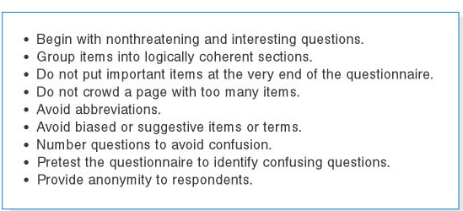
Questionnaires (cont)
Good questionnaire design
SEGI UNIVERSITY

Slide 30
Interviews Vs Questionnaires
SEGI UNIVERSITY
 | Interviews | Questionnaires
Information Richness | High | Medium to low
Time Required | Can be extensive | Low to moderate
Expense | Can be high | Moderate
Chance for follow-up & probing | Good | Limited – only done after original data collection
Confidentiality | Interviewee is known to interviewer | Respondent can be unknown
Involvement of subject | Interviewee is involved and committed | Respondent is passive, no clear commitment
Potential Audience | Limited numbers but complete responses | Potentially large – but lack of response can bias results
Adapted from Hoffer et al (2001), p. 212

Slide 31
Observing User
SEGI UNIVERSITY
Observation – the act of watching processes being performed.
It is a powerful tool to gain insight into the as-is system, and to check the validity of information gathered from other sources.
Nonetheless, people tend to be extremely careful in their behaviors when they are being watched.
Be unobtrusive
Identify peak and lull periods

Slide 32
Document Analysis
SEGI UNIVERSITY
Study of existing material describing the current system
Forms, reports, policy manuals, organization charts describe the formal system
Look for the informal system in user additions to forms/report and unused form/report elements
User changes to existing forms/reports or non-use of existing forms/reports suggest the system needs modification

Slide 33
Joint Application Development (JAD)
JAD is an information gathering technique that allows the project team, users, and management to work together to identify requirements for the system.
Purpose: collect system requirements simultaneously from key people
It can reduce scope creep by 50%,
JAD is a structure process in which 10 to 20 users meet under the direction of a facilitator skilled in JAD techniques.
SEGI UNIVERSITY

Slide 34
Selecting participants
Selecting JAD participants in the same basic way as selecting interview participants.
Facilitator
  Expert in JAD and e-JAD techniques
  In many cases, the JAD facilitator is a consultant external to the organization.
SEGI UNIVERSITY

Slide 35
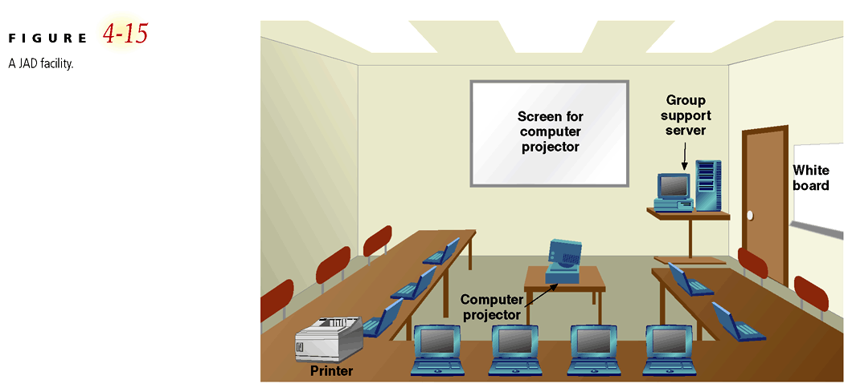
A JAD Facility
SEGI UNIVERSITY

Slide 36
Benefits of JAD
Time is saved, compared with traditional interviewing
Rapid development of systems
Improved user ownership of the system
Creative idea production is improved
End Result:
  Documentation detailing existing system
  Features of proposed system
SEGI UNIVERSITY

Slide 37
Prototyping
Goal: to quickly develop concrete specifications for the ultimate system
Iterative process
Gains initial requirements from user and documentation
Quickly converts requirements to working version of system
Once the user sees requirements converted to system, will ask for modifications or will generate additional requests
SEGI UNIVERSITY

Slide 38
Prototyping
Drawbacks
  Tendency to avoid formal documentation
  Difficult to adapt to more general user audience
  Sharing data with other systems is often not considered
  SDLC checks are often bypassed
SEGI UNIVERSITY

Slide 39
Selecting the Appropriate Techniques
Type of information
Depth of information
Breadth of information
Integration of information
User involvement
Cost
Combining techniques
SEGI UNIVERSITY

Slide 40
Selecting the Appropriate Techniques (cont)
SEGI UNIVERSITY
Comparison of Requirements Elicitation Techniques
 | Interviews | Question-naires | Observation | Document Analysis | JAD | Prototyping
Type of Info. (on which system?) | Current/ Improvements/ New | Current/ Improvements | Current | Current | Current/ Improvements/ New | Improvements/New
Depth of Info. | High | Medium | Low | Low | High | High
Breadth of Info. | Low | High | Low | High | Medium | Medium
Integration of Info. | Low | Low | Low | Low | High | High
User Involvement | Medium | Low | Low | Low | High | High
Cost | Medium | Low | Low-Medium | Low | Medium | Medium-High

Slide 41
REQUIREMENTS ANALYSIS STRATEGIES
SEGI UNIVERSITY
Problem Analysis
  Asking users to identify problems and solutions
  Improvements from problem analysis tend to be small and incremental
  This type of improvement is often very effective at improving a system’s efficiency or ease of use; however, it provides minor improvements in business value.

Slide 42
Root Cause Analysis
SEGI UNIVERSITY
Root cause analysis focuses on problems first rather than solutions.

Slide 43
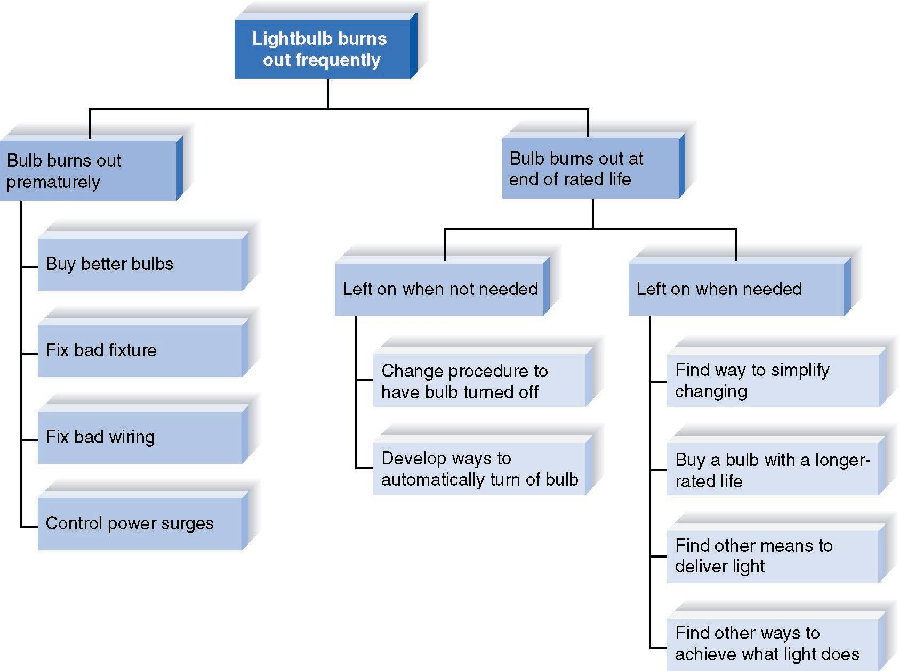
ROOT CAUSE ANALYSIS
SEGI UNIVERSITY

Slide 44
Duration Analysis
Duration analysis requires a detailed examination of amount of time it takes to perform each process in the as-is system.
Compare the total time to complete basic steps and the total time for the overall process – a significant difference indicates that the process is badly fragmented.
SEGI UNIVERSITY

Slide 45
Activity-Based Costing
SEGI UNIVERSITY
Activity-based costing examines the cost of each major process or step in a business process.
Both direct and indirect costs are considered.
The analysts identify most costly steps and focus improvement efforts on them.

Slide 46
Outcome Analysis
SEGI UNIVERSITY
Outcome analysis focuses on understanding fundamental outcomes that provide value to customers.
Think what the organization could enable the customer to do

Slide 47
Technology Analysis
SEGI UNIVERSITY
Technology analysis involves two steps:
1. The analysts and managers list important and interesting technologies.
2. Then, the group identifies how each and every technology might be applied to the business and how the business would benefit.

Slide 48
SUMMARY
Analysis focuses on capturing the business requirements for the system
Requirement Determination is the part of analysis in which the project team turns the business requirements stated in the system request into a precise list of requirements.
Five Requirements Elicitation Techniques can be used to elicit business requirements.
Requirements Analysis Strategies are useful for analysts to help the business users think critically about the new system requirements.
SEGI UNIVERSITY

Slide 49




Question Time

